Slide 1
Istio Service Mesh
Modern Traffic Management & Observability for Microservices

Slide 2
Agenda
What is Istio ?
Introduction to Istio
Components of Istio
6WH Model
Live Demo
Q&A

Slide 3
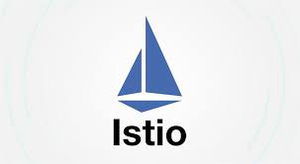
What is Istio?
Open-source Service Mesh for Kubernetes and VMs.
Provides a dedicated layer for managing service-to-service communication.
Handles traffic routing, security, observability, and reliability.
Istio has two primary modes: ambient mode and sidecar mode.
Ambient mode is the new and improved model, created to address the shortcomings of sidecar mode. In ambient mode, a secure tunnel is installed on each node, and you can opt in to the full feature set with proxies you install, (generally) per-namespace.
Sidecar mode is the traditional model of service mesh pioneered by Istio in 2017. In sidecar mode, a proxy is deployed along with every Kubernetes pod or other workload.

Slide 4
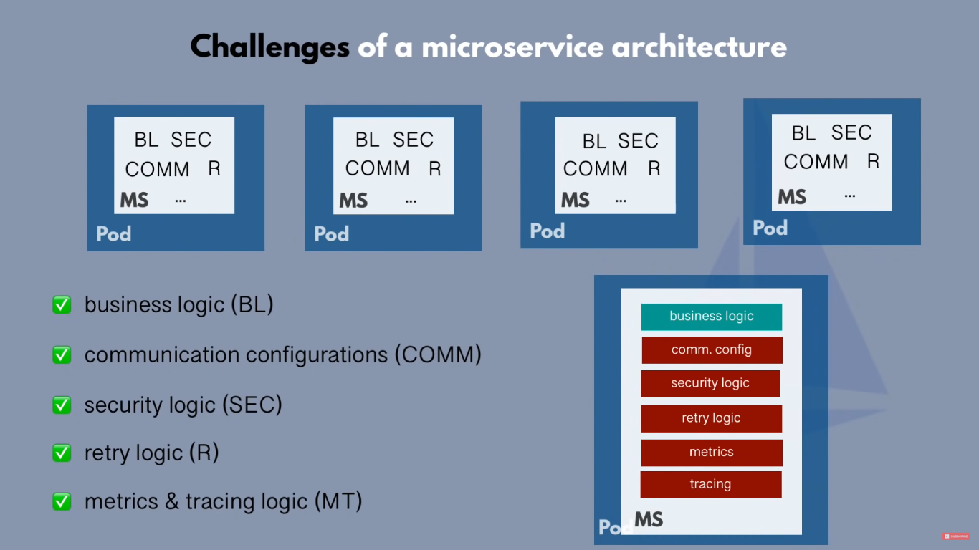
Introduction to Istio
Microservice without Istio

Slide 5
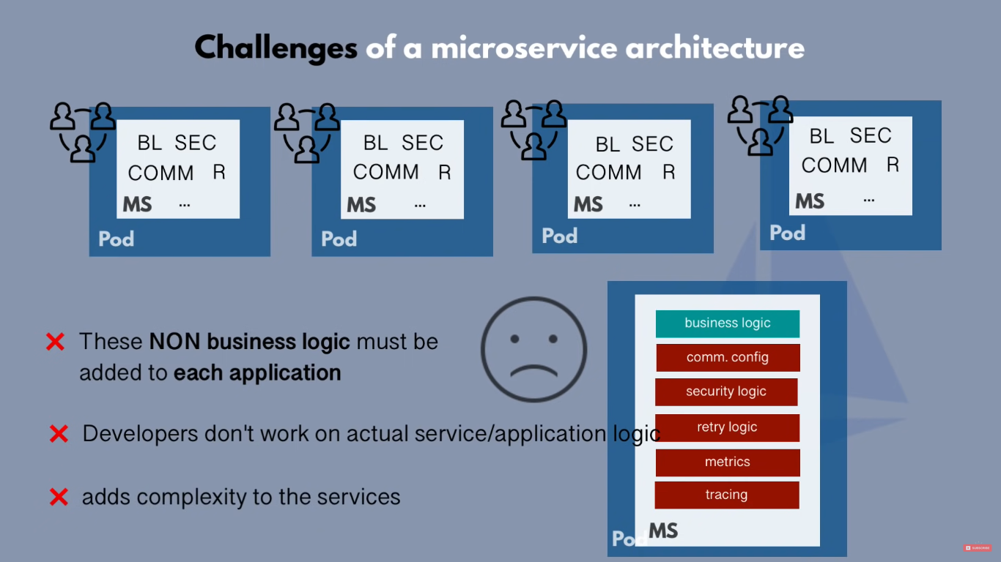
Introduction to Istio
Microservice without Istio

Slide 6

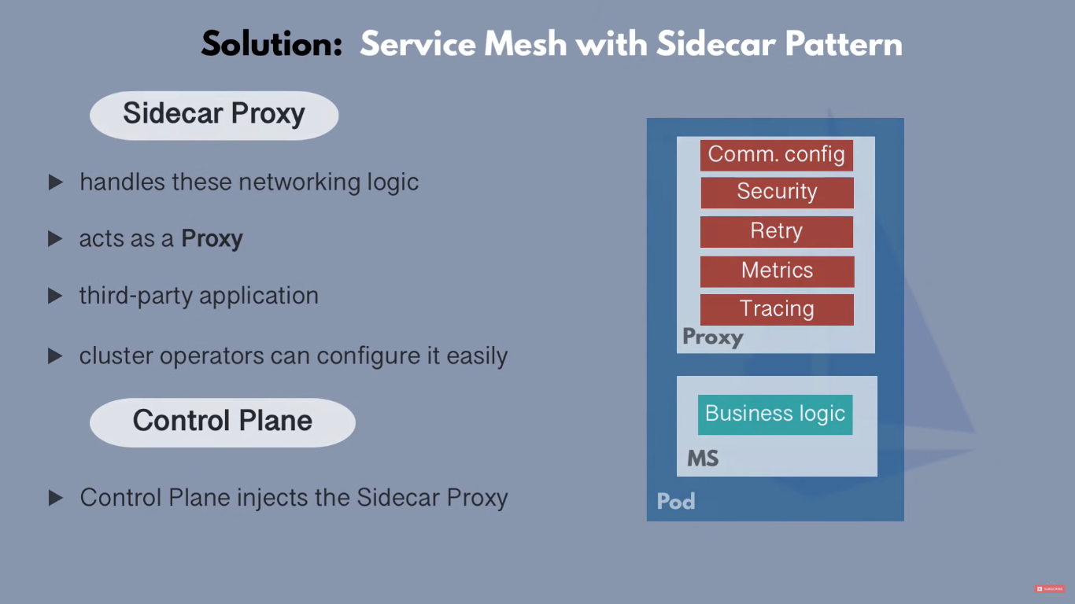
Introduction to Istio
Microservice with Istio (sidecar-Injection)

Slide 7
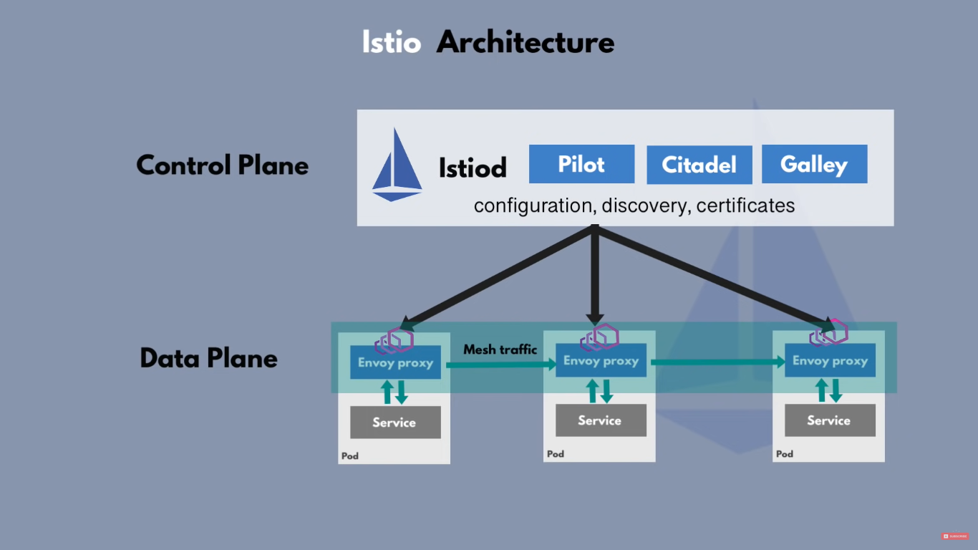
Components of Istio
Core Components
Istio has two core components like Control Plane and Data Plane.

Slide 8
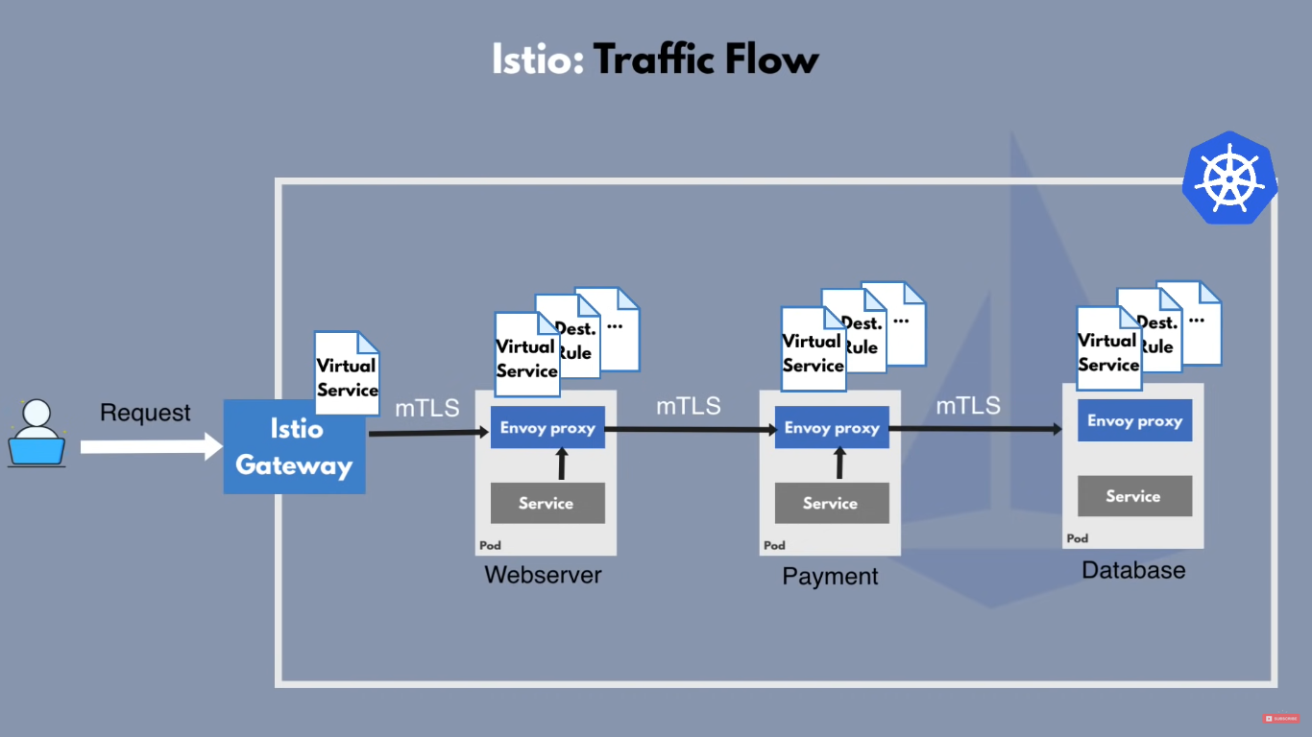
Components of Istio
Flow of Istio-Mesh in Microservice Architecture

Slide 9

Why Istio?
Observability (metrics, logs, traces with Prometheus, Grafana, Jaeger, Kiali)
Traffic Control (routing, canary, blue-green)
Security (mTLS, RBAC, JWT validation)
Reduces developer burden (infra-managed features)

Slide 10


What if Istio is NOT Available?
Retries, timeouts, circuit-breaking (complex logic in code)
mTLS, JWT authentication, certificates
Logging & tracing → inconsistent & duplicated across services
Leads to inconsistent policies, security gaps, and harder debugging

Slide 11



What are the Alternatives?
Linkerd – Lightweight, simpler than Istio
Consul Connect – Service mesh from HashiCorp
Kuma (by Kong)
Native Kubernetes + manual sidecars (complex, not scalable)

Slide 12
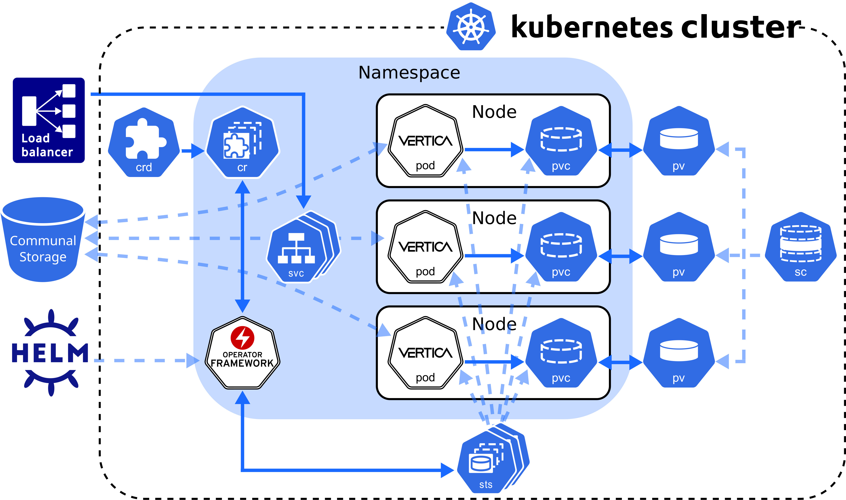
When to Use Istio?
Large-scale microservices-based architectures
Need fine-grained traffic routing (canary, A/B testing)
Zero-trust security model with automatic mTLS
Teams that need unified observability (logs, metrics, traces)
Enterprises adopting multi-cluster / hybrid cloud

Slide 13
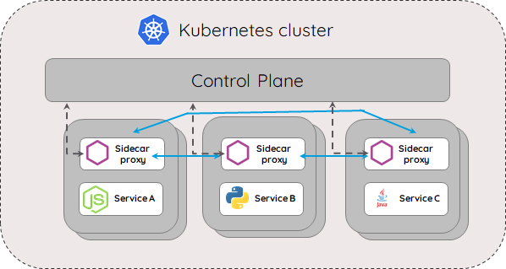
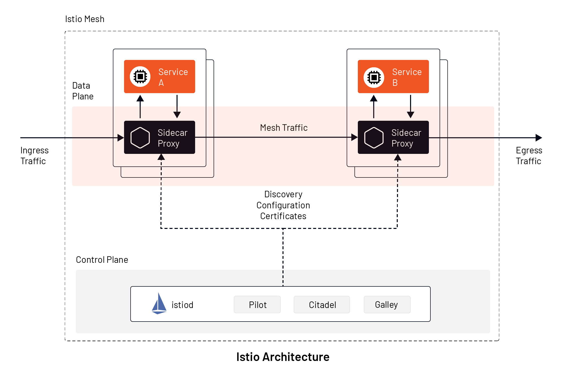
Best Scenarios for Istio
Progressive rollouts: Canary, blue-green deployments
Resiliency: Automatic retries, circuit-breaking, failovers
Policy enforcement: Rate limiting, quotas, auth
Observability: Monitor service-to-service latency, error rates
Security: End-to-end encryption with minimal dev effort

Slide 14

How to implement Kubernetes?
Implement the Istio-service mesh on microservice
Request Routing
Circuit Breaking
Enabling Mutual TLS
Access Control with JWT

Slide 15

Q & A

Slide 16
Abishek K
Junior - Software Engineer

